Slide 1
1. Main Screen Configuration
Caption Bar
Preset display screen
Program display screen
Transition control
Playback Control System
2021-02-24 12:00:00
Setting
-
□
X
PST(Preset/Preview)
PGM(Program)
Control Panel
Media 1
Media 2
Input 1
Input 2
CG 1
CG 2
CG 3
Transition
Media 1
Media 2
CG 1
CG 2
CG 3
Audio Mixer
Input 1
Input 2
Record 1
Type-specific settings
Audio Mixer & Input/Record settings
Transition & Device settings(except the input device)
Device preview display screen
Displayed according to the number of device’s setting.
Audio Mixer & Input/Record settings

Slide 2
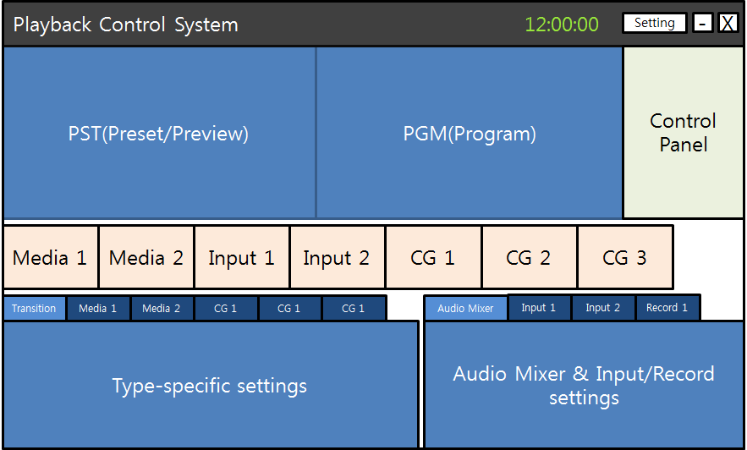



2. PST/PGM Configuration
Preset/Program screen name
Preset
Program
Audio peak level meter

Slide 3

3. Control Panel Configuration
CG classification
Displayed according to the number of CG’s setting.
CG 1
CG 2
CG 3
Fader
PGM
PGM
PGM
CG PGM display ON/OFF button with key transition
PST
PST
PST
CG PST display ON/OFF button with key transition
Performs
the current transition
TIE
TIE
TIE
Set the key to work with the transition
AUTO
CUT
Always performs
the cut transition
Fade
Fade
Fade
Fade
Current key transition
settings
S
M
F
C
S
M
F
C
S
M
F
C
S
M
F
C
60
Frames
60
Frames
60
Frames
60
Frames
Current main transition
settings

Slide 4
4. Device Preview Configuration
Device setting button
Device name
Media 1
Device preview
Media
Input video
CG
Audio peak level meter

Slide 5



5. Transition & Device Settings Configuration
5.1. Transition Settings
Transition & Device select tab
Transitions and devices are displayed.(except input device)
Displayed according to the number of device’s setting.
Transition
Media 1
Media 2
CG 1
CG 2
CG 3
Main
Transition properties
CG 1
CG 2
CG 3
Device transition settings
Program & Devices requiring transitions
Main program
CG
Select transition effect
Fade
Horizontal edge wipe
etc

Slide 6


5. Transition & Device Settings Configuration
5.2. Media Device Settings
Transition
Media 1
Media 2
CG 1
CG 2
CG 3
Media preview & track bar
File Name | Duration | Path
P201703300001.mxf | 00:30:00:00 | D:\Media\MXF
P201703300002.mxf | 00:25:00:00 | D:\Media\MXF
P201703300003.mxf | 00:20:00:00 | D:\Media\MXF
P201703300004.mxf | 00:05:00:00 | D:\Media\MXF
P201703300005.mxf | 00:10:00:00 | D:\Media\MXF
00:00:21:15
Media add/delete
Media list
Media current time
Eject
Media playback control

Slide 7

5. Transition & Device Settings Configuration
5.3. CG Device Settings
Transition
Media 1
Media 2
CG 1
CG 2
CG 3
Layer 1
Layer list
Layer 2
Title
Layer 3
Layer add/delete/modify
CG preview

Slide 8

6. Audio Mixer & Input/Record settings Configuration
6.1. Audio Mixer
Audio mixer & Input, Record select tab
Audio mixer and Input devices are displayed.
Displayed according to the number of device’s setting.
Audio Mixer
Input 1
Input 2
Record 1
Device
audio level
Master
audio level
Input 1
Input 2
Media 1
Media 2
CG 1
CG 2
CG 3
Master
Master
on/off
Select whether to include in master output

Slide 9
6. Audio Mixer & Input/Record settings Configuration
6.2. Input Device Settings
Audio Mixer
Input 1
Input 2
Record 1
Video
Video device name
Video settings
Resolution
Audio
Audio device name
Channels
Audio settings
Bits per sample
Sample per sec

Slide 10


6. Audio Mixer & Input/Record settings Configuration
6.3. Record Settings
Audio Mixer
Input 1
Input 2
Record 1
Format
Format select
Format settings
Resolution
Bitrate
Frame rate
Input select – Input device or master output
Input source select &
Record destination setting
Destination
Record start/stop

